Slide 1
Setup and Run
Instructions

Slide 2
Install:
Python 3.6
PyCharm Community
Possibly Anaconda 3

Slide 3
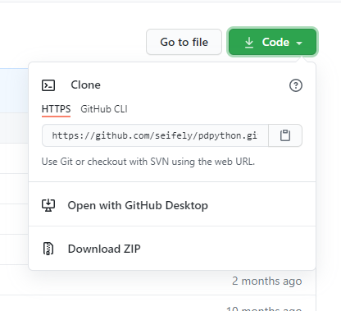
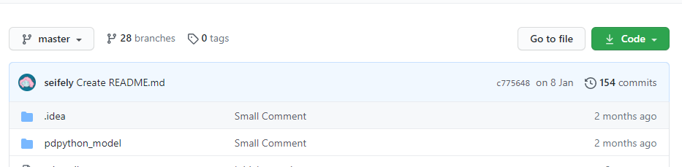
Download the Repository with the code:
https://github.com/seifely/pdpython/tree/4by4_test

Slide 4
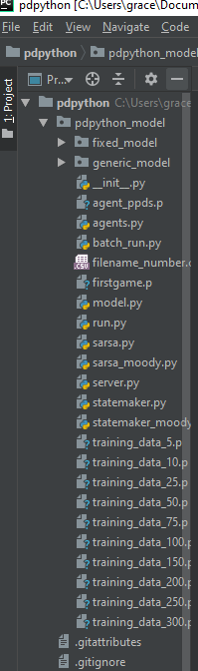
In PyCharm
Open the main folder ‘pdpython’ as a project
Open the folder ‘pdpython_model’ in the subfolder menu to the left
Before we can run it we need to set up the virtual environment/Python interpreter

Slide 5
VENV/Python Interpreter
In Pycharm, go to File → Settings
In the left menu, go to Project: pdpython → Project Interpreter
To the right of the file path at the top, you will need to click the cog/settings button and then click ‘Add’
Stick with the default settings for ‘Virtualenv Environment’ → New Environment, but you will need to find the location of the python.exe executable in the folder you saved Python 3.6 into
Once the ‘Base Interpreter’ is pointing at 3.6, click ‘OK’

Slide 6
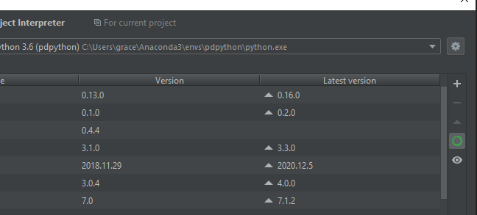
Installing Dependencies
Once the virtual environment is set up, you will need to install the libraries the simulation uses
Click the little ‘+’ symbol next to the list of already installed libraries
The main libraries required are:
Mesa
Matplotlib
NetworkX
Pyvis
NumPy
Pandas
Scipy
If mesa does not show up, the alternative involves installing Anaconda and making a venv to run the simulation using that instead.

Slide 7

Using Anaconda Instead (Optional)
Once Anaconda is installed, open Anaconda Navigator
On the left, click on ‘Environments’ and then in the bottom middle click ‘Create’. Make a note of the location it saves the venv to, and ensure the version of Python it uses is 3.6. This will create a basic conda virtual environment (I call it pdpython to match the folder but it doesn’t matter too much).
In the list of environments, select the one you just created. It should take a second to switch and load. When it does, click the little arrow next to its name in the list that looks like this: Then, select ‘Open Terminal’

Slide 8
Using Anaconda Instead (Continued)
With the terminal open, type ‘pip install mesa’. Wait for it to collect and install the library and its dependencies.
Once this has finished installing, do the same command with scipy. I believe these are enough to get the simulation running
With both installed, close Anaconda and the terminal and go back to PyCharm
Open up the File → Settings → Project: pdpython → Project Interpreter and then click the cog to the right of the file path, and select ‘Add’ from the drop-down menu

Slide 9
Using Anaconda Instead (Continued)
Select ‘Conda Environment’ from the left hand side and tick the ‘Existing Environment’ option. You need to then use the triple dots to the right of the empty file path to navigate to where the conda environment is (should have been visible when you created the environment)
Select the python.exe in the venv folder you just set up, and then click ‘OK’ on all the dialogue box
Click ‘OK’ on the dialogue box to add the python interpreter
Click ‘Apply’ and then ‘OK’ on the last dialogue box remaining to attach it to the project

Slide 10
In PyCharm
Open the main folder ‘pdpython’ as a project
Open the folder ‘pdpython_model’ in the subfolder menu to the left
Before we can run it we need to set up the virtual environment/Python interpreter
Once the interpreter is set up, running either the moody_run or the sarsa_run files should allow for single experiments with the visualiser enabled - please set the parameters you desire on the left, and then click ‘RESET’ in the top right in order to run the experiment with the parameters active
To run the experiment over many epochs, set the desired variables at the bottom of the batch_run.py file (including number of iterations), and run that file instead.

Slide 11
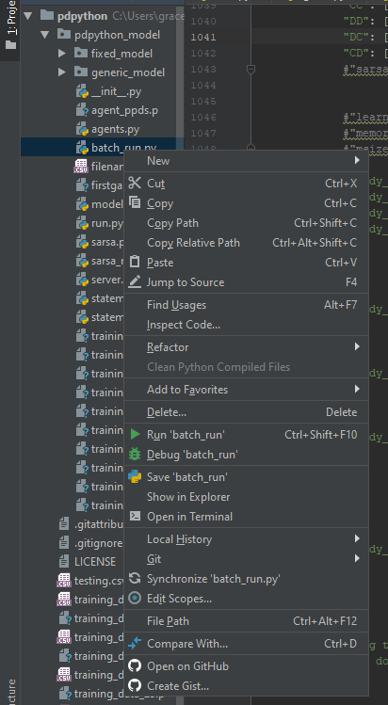
To run the simulation using the Batchrunner (many epochs)
Ensure your variables are set correctly at the bottom of the batch_run file, and ensure the automatic file name generator is structured as you desire (around line 586).
Right-click the file in the hierarchy called ‘batch_run.py’ and select ‘Run ‘batch_run’’ from the drop-down menu
The simulation should start running if all stages have been done correctly. There is no visualiser, it will just run in the background and be constantly outputting/modifying the data into csv files in the pdpython_model folder
These .csv files shouldn’t be touched until the simulation has ended, otherwise it will crash as the data storage path will be blocked
Once the simulation has ended, the terminal at the bottom of the screen will display a red string that gives the length of time it took to run in hours/minutes, followed by number of seconds per iteration

Slide 12
To run the simulation using the Visualiser (single epoch)
Right-click the file in the hierarchy called ‘moody_run.py’ or ‘sarsa_run.py’ and select ‘Run [filename]’ from the drop-down menu
The simulation should start running if all stages have been done correctly. The visualiser opens on a localhost port (http://127.0.0.1:8521 for me, unsure if It remains the same, but it should come up in the pycharm terminal for you to click on/may open in your default browser automatically)
These .csv files shouldn’t be touched until the simulation has ended, otherwise it will crash as the data storage path will be blocked
Once the simulation has ended, the terminal at the bottom of the screen will display a red string that gives the length of time it took to run in hours/minutes, followed by number of seconds per iteration

Slide 13
Other Notes
If you could add the data files to a .zip folder and send them to me, I can process them when I have MATLAB available. Don’t touch or move the .csv files named ‘filename_number.csv’, other than to reset it to zero if you need to after an experiment.
The simulation takes up a decent chunk of memory (approximately 30% on the work PCs each) so it is possible to do other stuff whilst it’s running but other memory-intensive programs will result in a simulation crash.

